Slide 1
CAPITAL BIKESHARE
Arfa Tahir, Kirill Kim, Matthew Ng, Riwaaz B. Sijapati, Sangmo Lama, Tugba Yildirim
Team 5

Slide 2
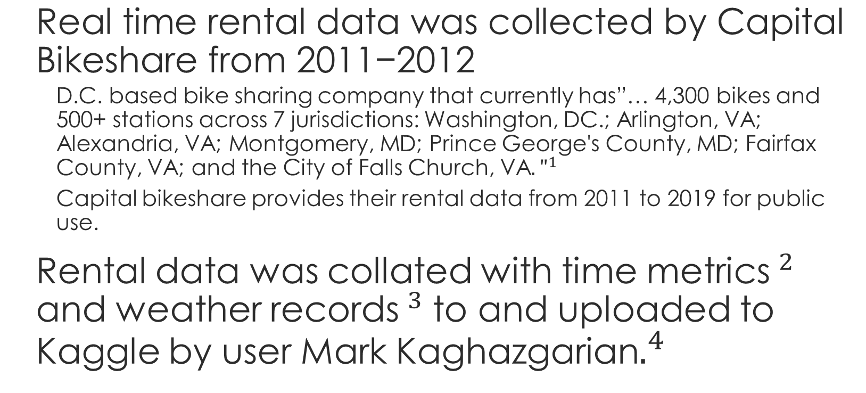
BACKGROUND
http://capitalbikeshare.com/system-data
http://dchr.dc.gov/page/holiday-schedule
http://www.freemeteo.com
https://www.kaggle.com/marklvl/bike-sharing-dataset

Slide 3
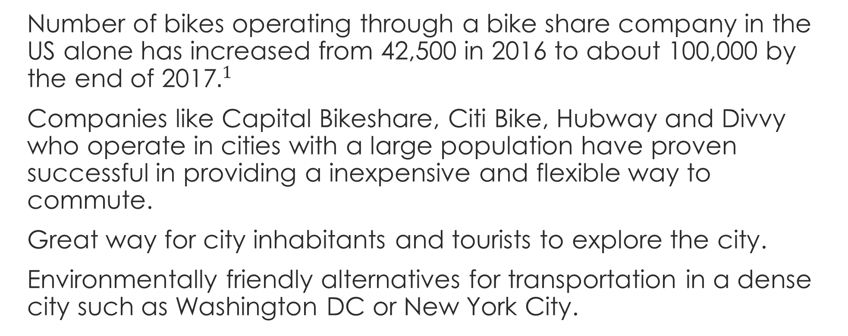
MOTIVATION
https://nacto.org/wp-content/uploads/2018/05/NACTO-Bike-Share-2017.pdf

Slide 4
CAN WE PREDICT BIKE RENTALS BASED ON TIME AND WEATHER METRICS?

Slide 5
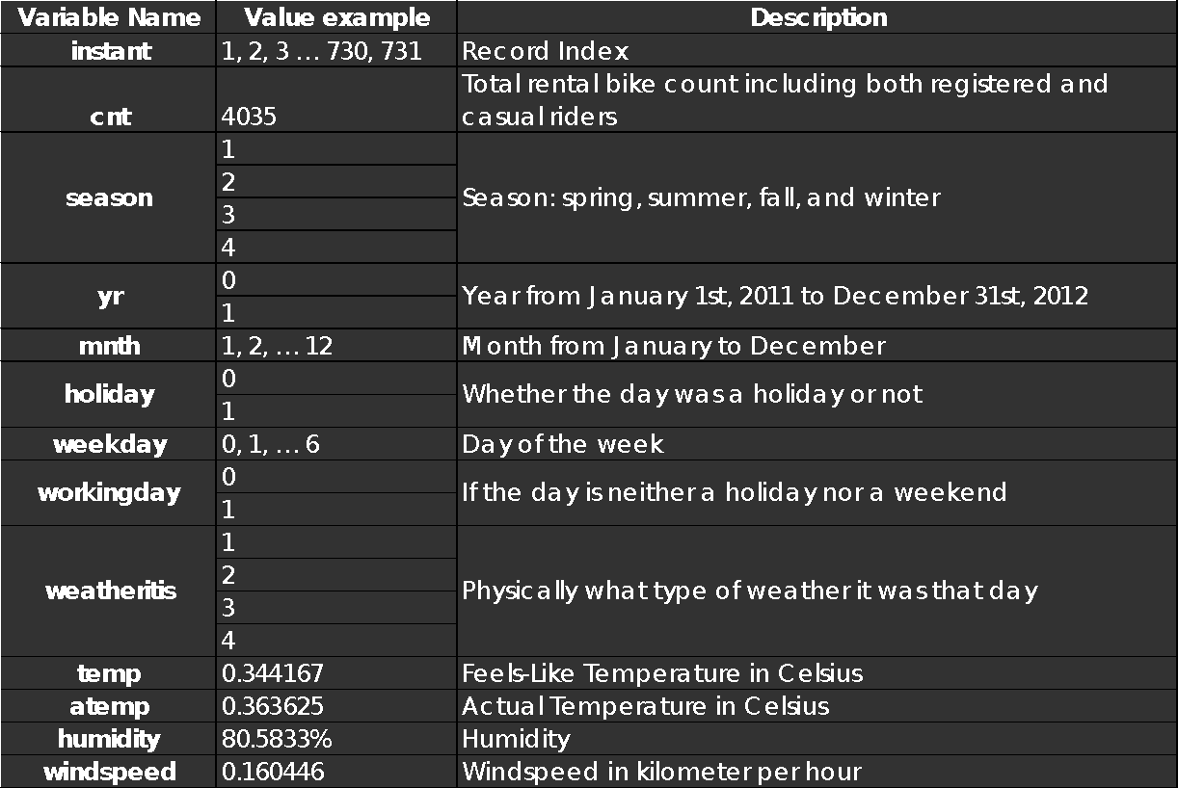
RAW DATASET

Slide 6
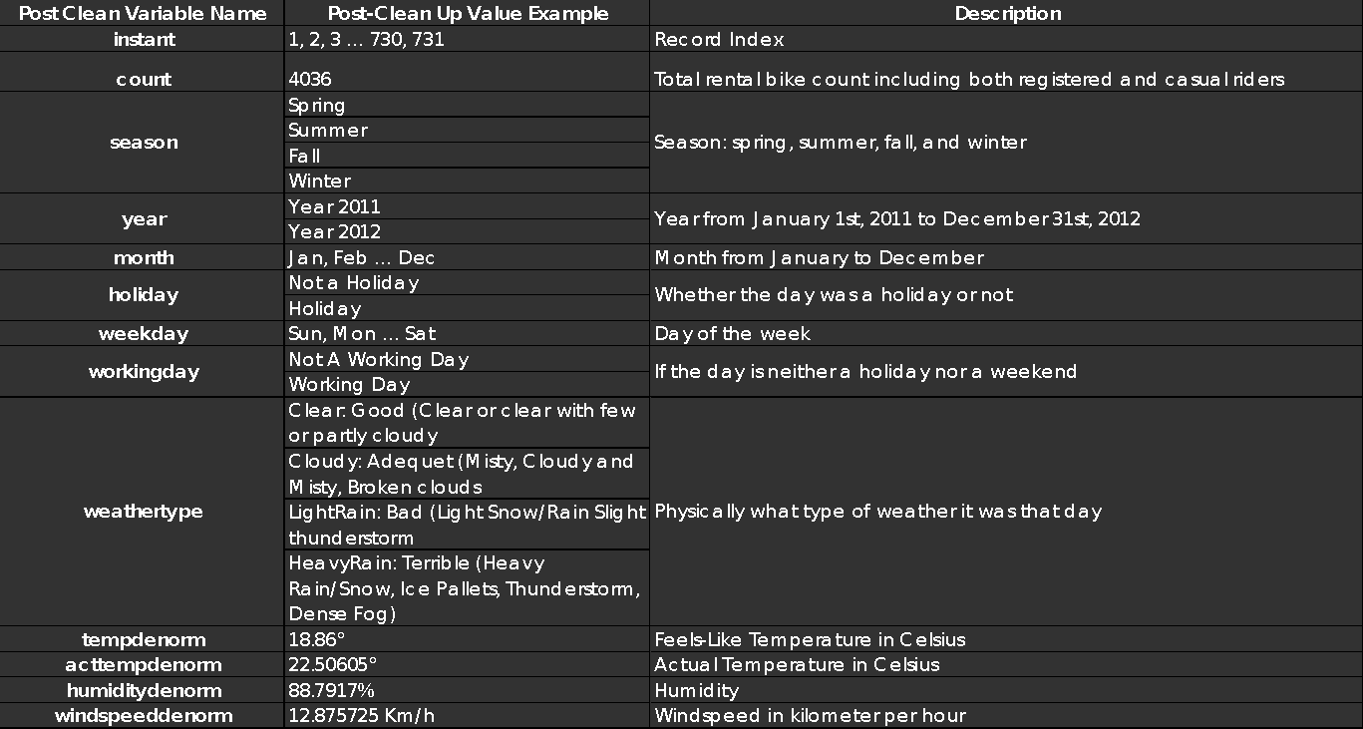
POST CLEANUP DATASET

Slide 7
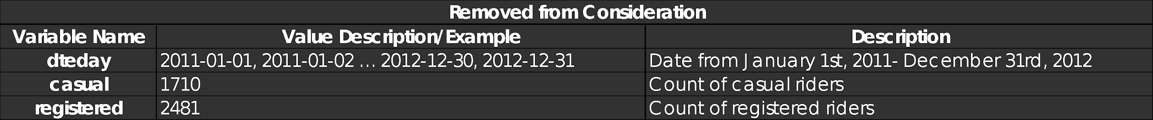
REMOVED FROM CONSIDERATION

Slide 8
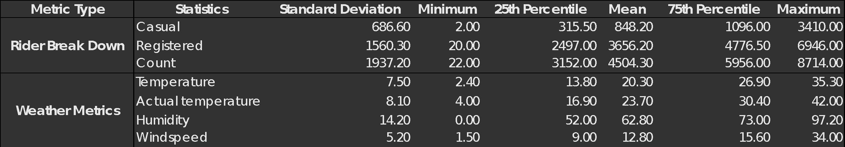
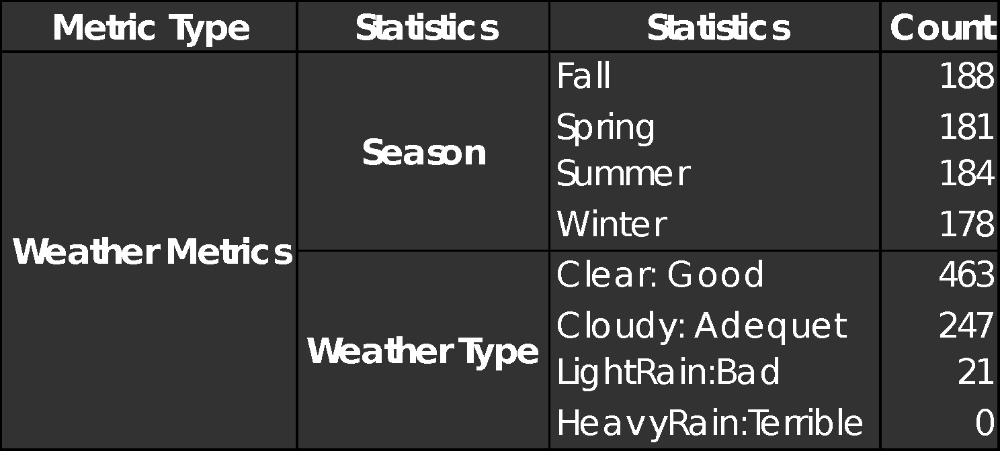
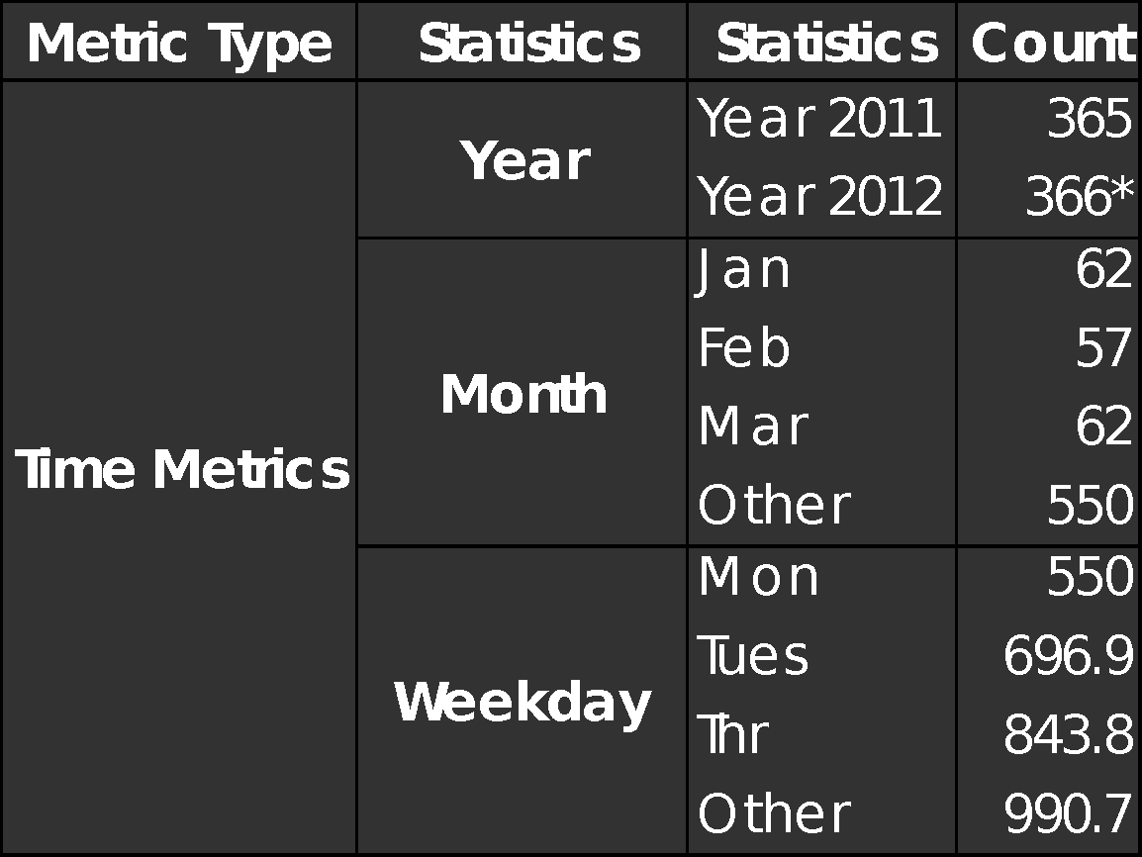
DATA SUMMARY STATISTICS

Slide 9


TYPE OF DAY
68.40%
90.91%
31.60%
Holiday
9.09%
Not a Holiday
Working Day
Not A Working Day

Slide 10
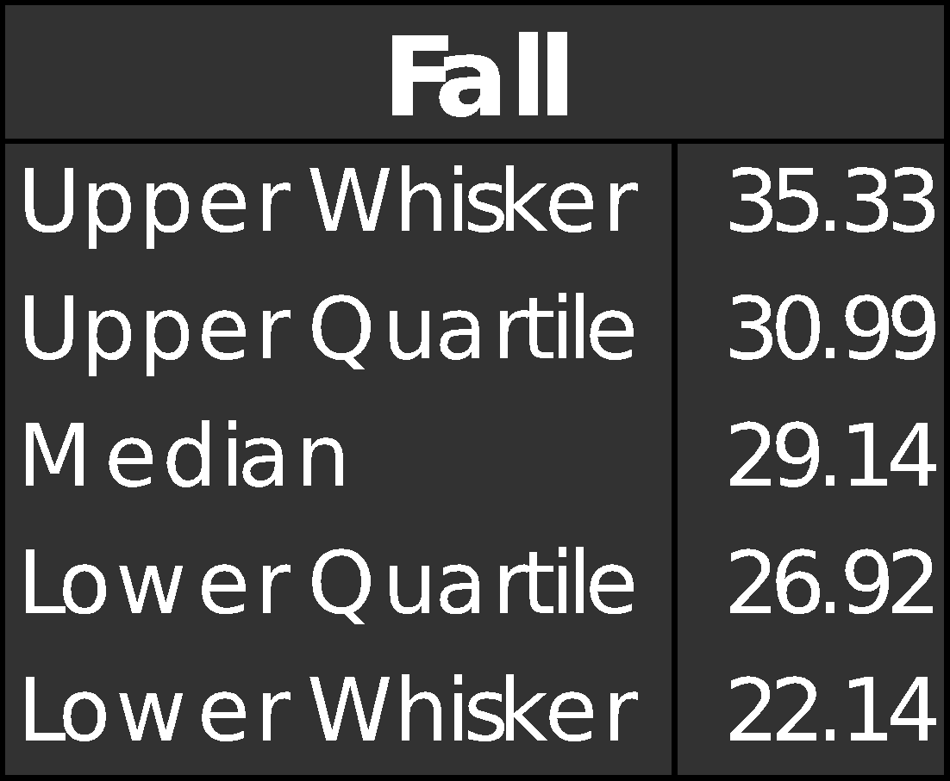
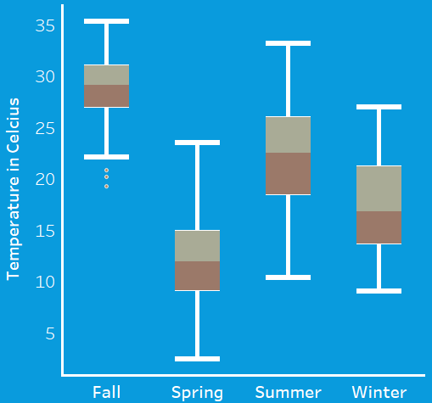
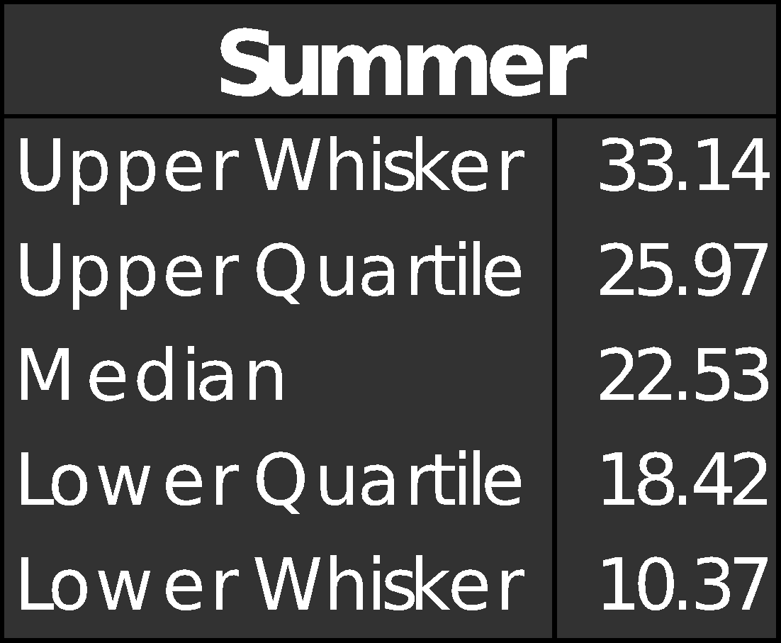
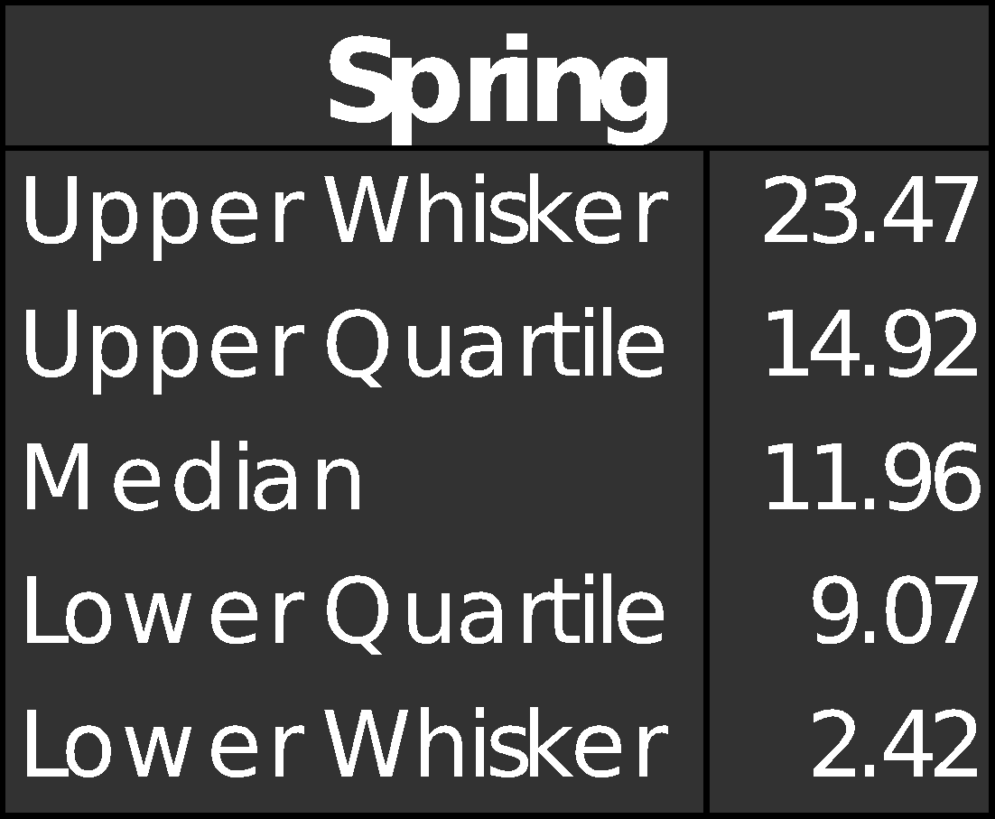
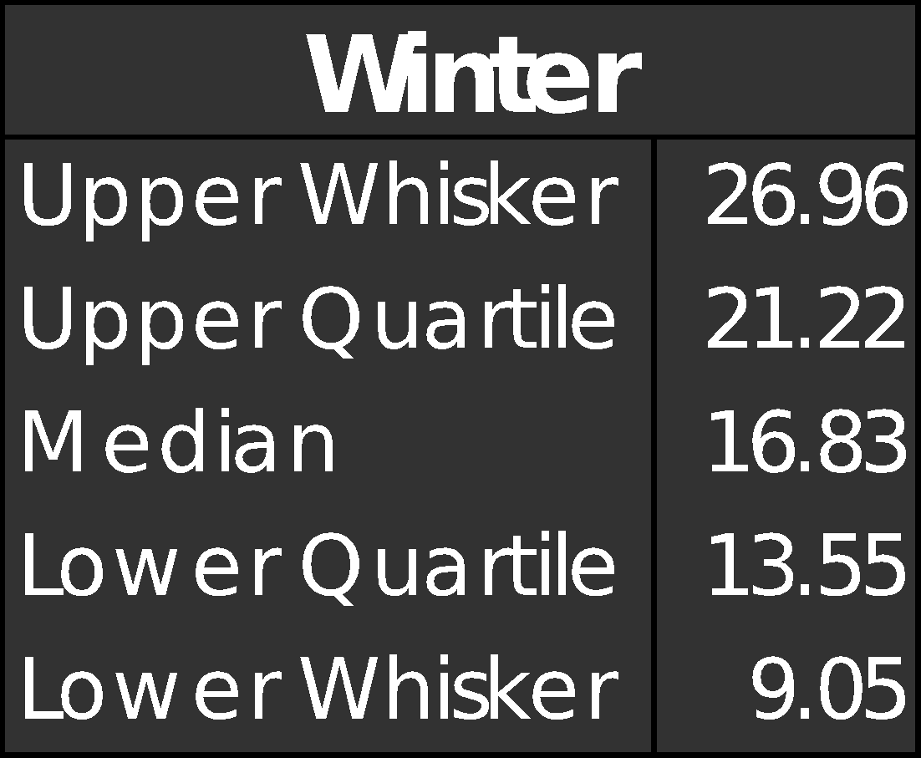
TEMPERATURE-SEASON BOX PLOT IN CELSIUS

Slide 11
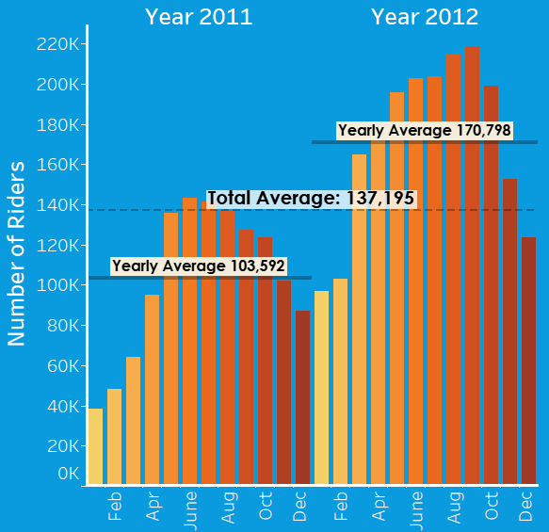

Slide 12
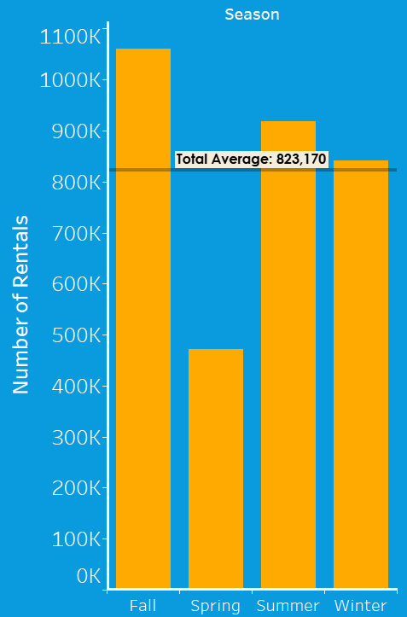

Slide 13
DATA MINING METHOD
Multilinear Regression
We used multi linear regression, as there are multiple independent variables that could affect the number of bikes rented.
For instance, weather conditions, precipitation, day of week, season and other factors can affect the rental behaviors. We expect to see multilinear relationship between the total number of bike rental users and the variables of interest
We used the multiple linear regression model, then evaluate the adequacy of the fitted model by doing a cross validation
Regression Tree
They are very interpretable.
Making predictions is fast (no complicated calculations, just looking up constants in the tree.
It’s easy to understand what variables are important in making the prediction. The internal nodes (splits) are those variables that most largely reduced the SSE.

Slide 14
MULTILINEAR REGRESSION
Method used to determine important variables: Backward Selection.
Removed working day, weekday and actual temperature from model
Original model issues:
Year variable had a high effect on model, but was not important for our purposes so it was removed.

Slide 15
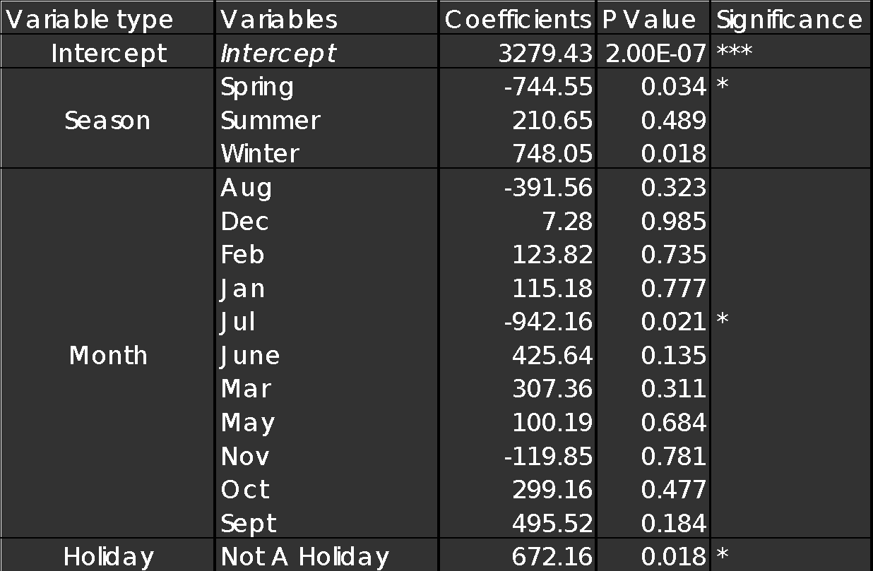
MULTILINEAR REGRESSION ANALYSIS

Slide 16
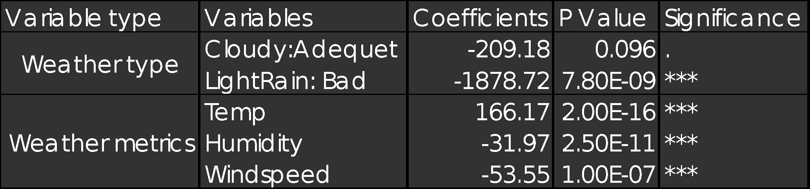
MULTILINEAR REGRESSION ANALYSIS
Multiple R-Squared Value = .584
Lowest Cross Validation MSE achieved = 1649346

Slide 17
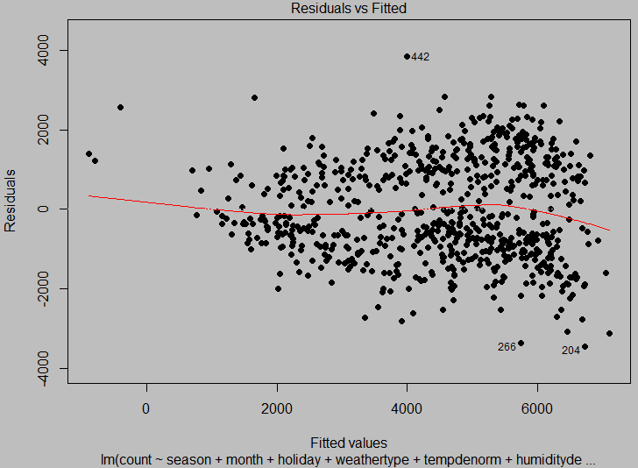

Slide 18
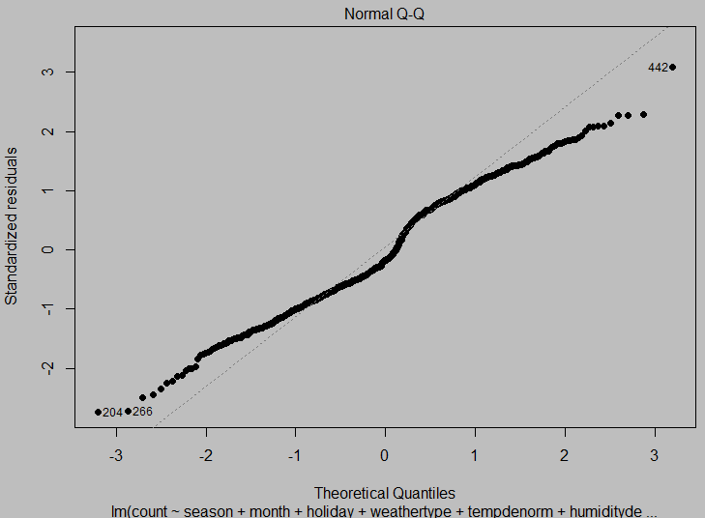

Slide 19
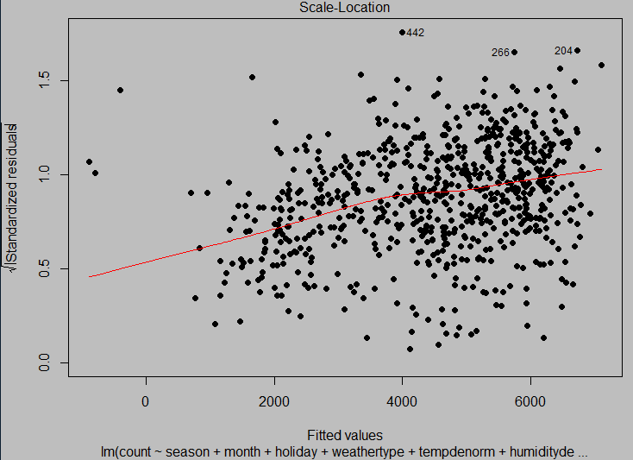

Slide 20
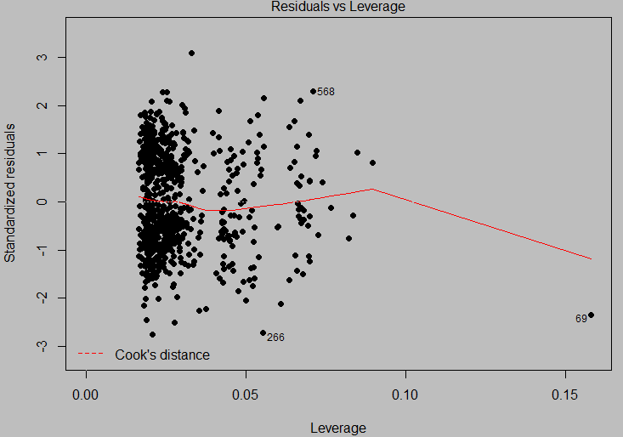

Slide 21
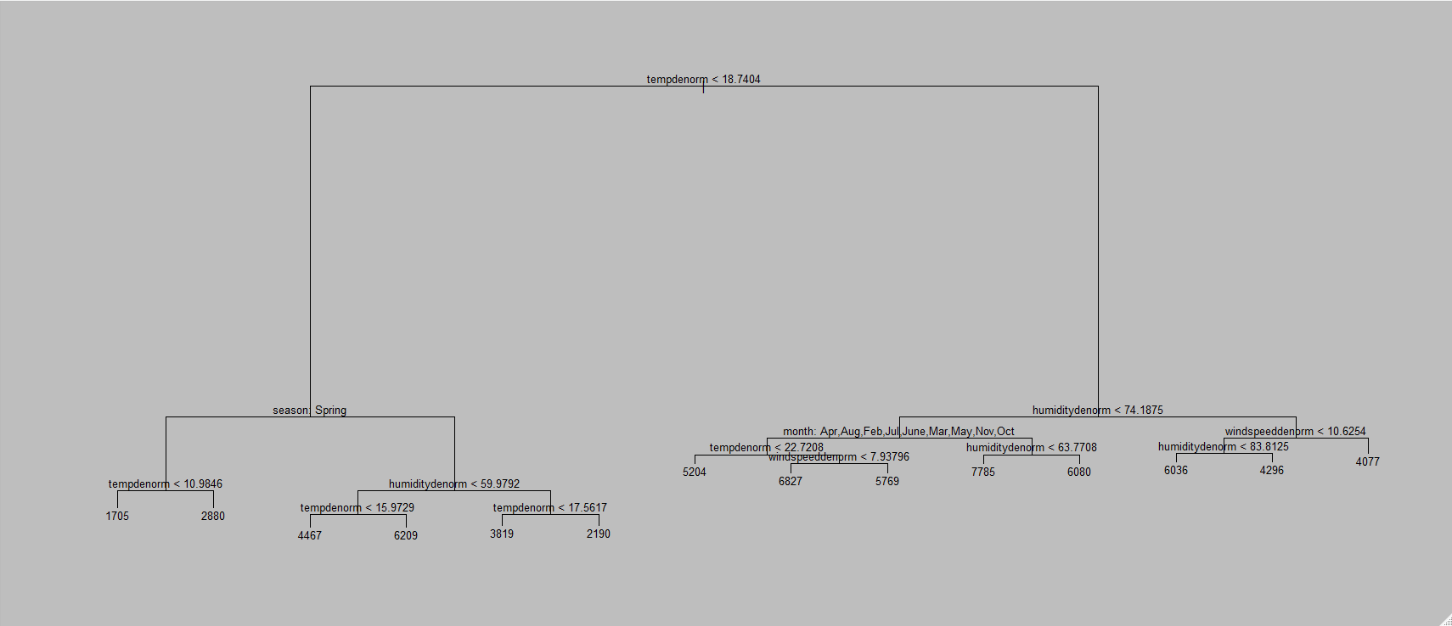
REGRESSION TREE
we create a training set, and fit the tree to the training data
We find the variables actually used
"tempdenorm“, "season“,"humiditydenorm“, "month“, "windspeeddenorm“
Terminal Nodes : 14
residual mean deviance: 1298000 = 455600000 / 351

Slide 22
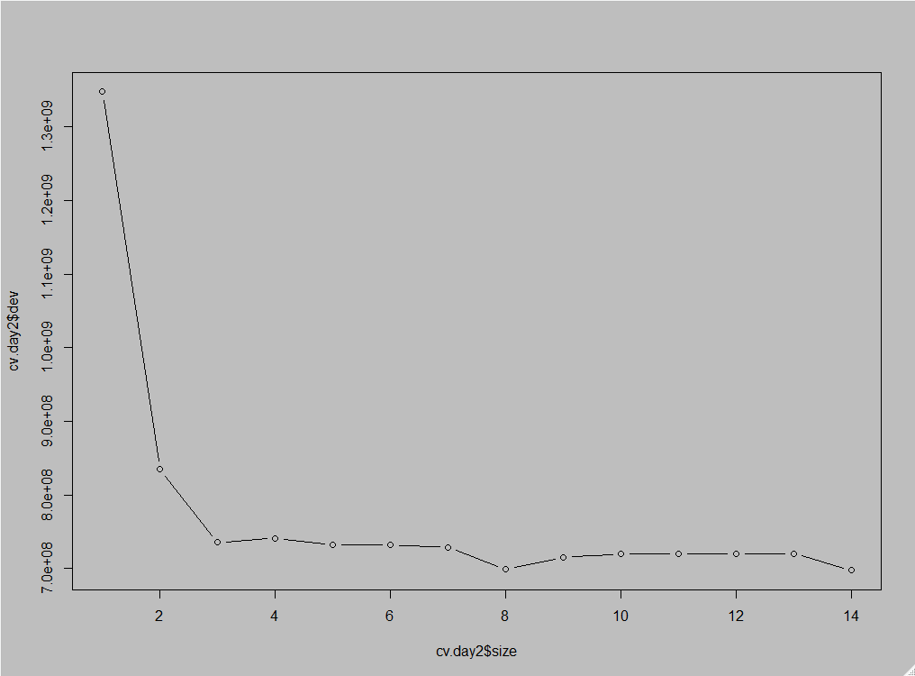

Slide 23
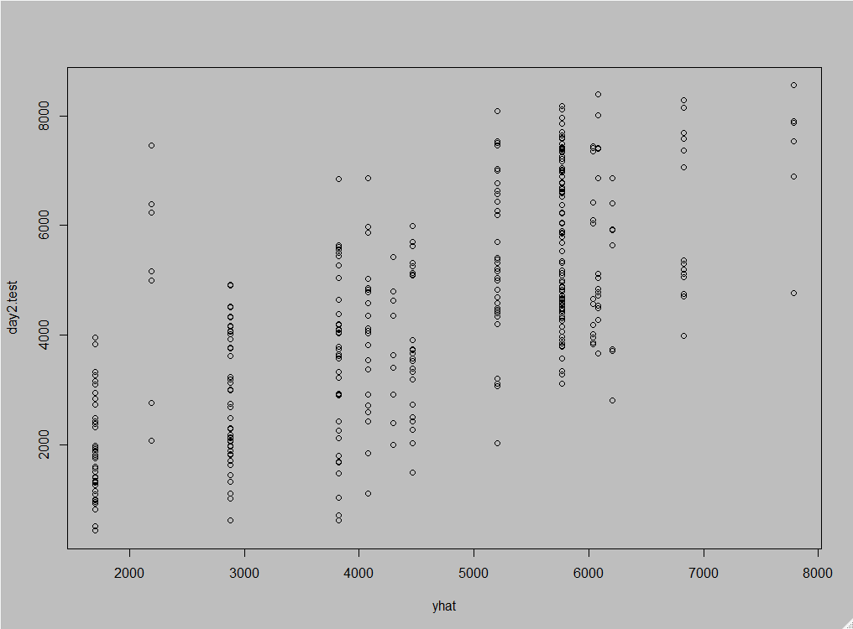

Slide 24
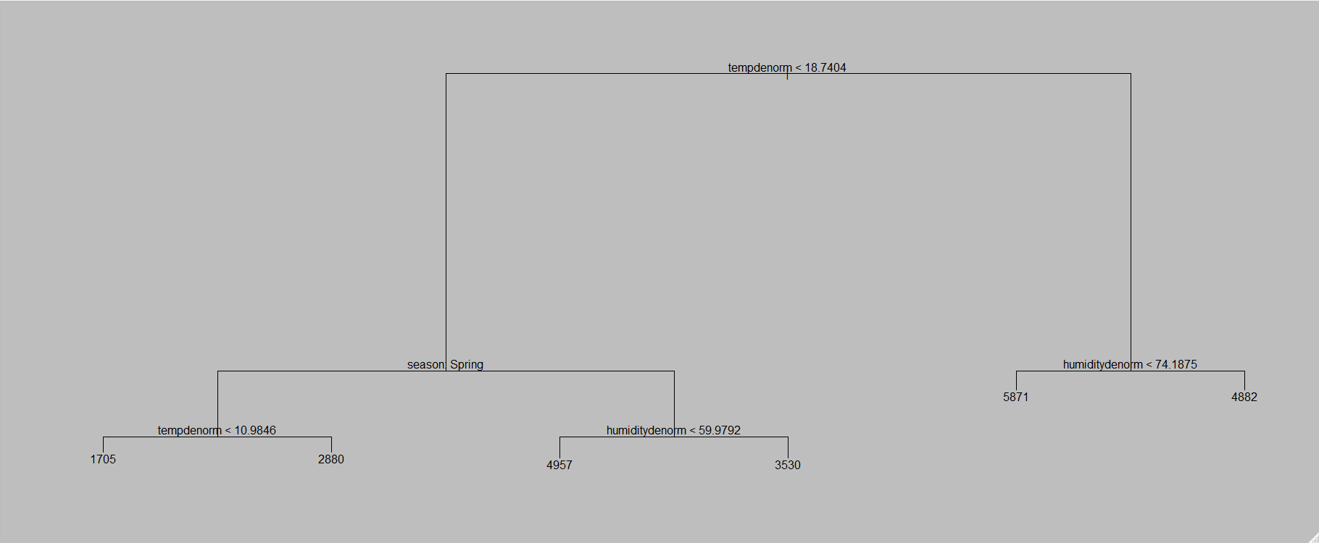
PRUNE TREE
We pruned the tree (by doing cross validation on the training dataset to determine the best tree)
We use pruned tree to make prediction on the test data
we calculated the predicted value of DV on the test data using the trained model
We Calculated the Mean Squared Error to be 2052060

Slide 25
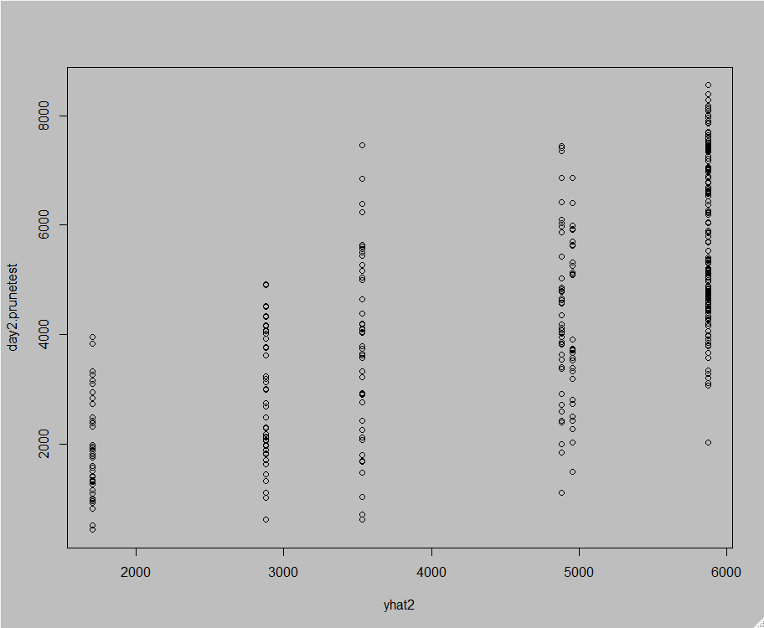

Slide 26
CONCLUSION
Choice of model: Multi Linear Regression
Attained lower MSE
To make the model stronger we should probably consider other variables
Such as hourly rentals

Slide 27
PRACTICAL IMPLICATIONS
The major usage of this project would be to forecast bike rentals for the coming years based on the independent variables, ‘Time Metrics’ and ‘Weather Records’.
Also, this analysis can be used in helping a company interested in starting a bike sharing service in cities with similar weather conditions as D.C.
China Bike Pile
There is a oversupply of bikes in China that ends up in bike graveyard
These bikes can be repurposed and used for bike sharing services.

